Slide 1





1/40
The index input terminal on the Replace Array Subset function is unwired.
What value will be displayed in the Output Array indicator after the VI completes execution?
Notes:
A：
B：X
C：
D：X

Slide 2
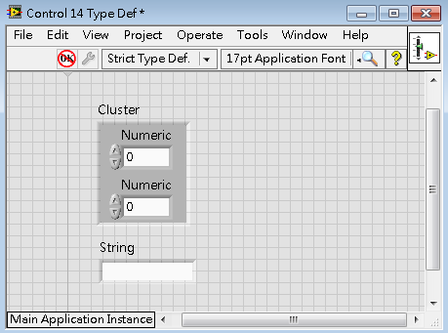
3/40
Why is the Control “Control 1 Strict Type Def” broken?
  It has not yet been saved.
  A strict type definition cannot contain a cluster.
  There are two controls with the same name (Numeric and Numeric)
  There are two top-level controls (Cluster and String).
Notes:
A：
B：XXX
C：XXXX
D：

Slide 3
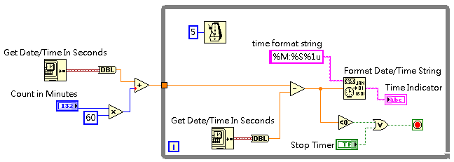
4/40
The value in the Count in Minutes control is 4.
When the VI is in execution what does the Time Indicator display?
  Time counting up with the string format similar to 12:04:05.20
  Time counting down with the string format similar to 12:03:55.45
  Time counting up with the string format similar to 4:05.2
  Time counting down with the string format similar to 3:55.5
Notes:
A：
B：
C：XX
D：

Slide 4
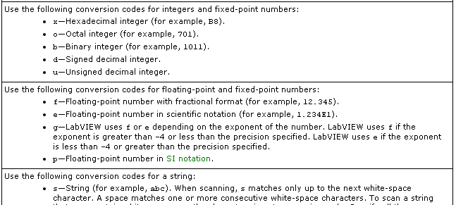
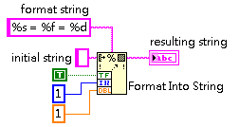
5/40
What value will be displayed in the resulting string indicator when the VI completes execution?
    TRUE = 1 = 1.000000
    T = 1 = 1.000000
    TRUE = 1.000000 = 1
    1 = 1 = 1.000000
Notes:
A：XXX
B：
C：
D：

Slide 5
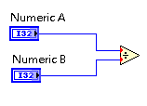
6/40
If you wire two I32 values to the inputs of the Divide function, what is the default data type of the output terminal of the Divide function?
  64-bit unsigned integer
  64-bit signed integer
  64-Bit real (floating-point)
  32-bit signed integer
Notes:
A：
B：
C：
D：XX

Slide 6

Automatic error handing is enabled for this VI.
Does LabVIEW display an error to the user when the VI completes execution?
  Yes, the error is handled by the Simple Error Handler.
  No, no error is displayed because non of these bode can generate an error.
  No, no error is displayed because closing the file reference clears the error.
  Yes, twice once for the Simple Error Handler VI and once when automatic error handling displays the error from the unwired error out of Simple Error Handler VI.
Notes:
A：
B：X
C：X
D：XX

Slide 7
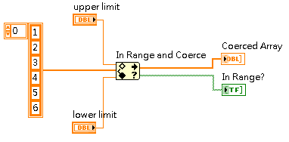
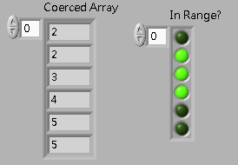
18/40
What values in the Upper Limit and Lower Limit controls produce the arrays displayed on the front panel?
  Upper Limit = 5 ; Lower Limit = 1
  Upper Limit = 5 ; Lower Limit = 2
  Upper Limit = 6 ; Lower Limit = 1
  Upper Limit = 6 ; Lower Limit = 2
YH
Notes:
A：
B：
C：ＸX
D：

Slide 8
19/40
Which VI server node do you use to access the methods of a front panel object?
  Property Node
  Constructor Node
  Invoke Node
  Variable Node
Notes:
A：X
B：
C：
D：

Slide 9
21/40
What is a recommended use of local variable?
  To initialize the value of a control
  To update value of a control
  To communicate the latest value of a control
  To transfer every point of data between parallel loops
Notes:
A：
B：
C：X
D：XXXXXXX

Slide 10
22/40（刪去法）
Which debugging technique is possible?
  Single step when the execution flow is paused on multiple selected nodes.
  Step into a Dequeue Element function.
  Step over when the execution flow is paused on an Enqueue Element At Opposite End function.
  Step Back when the execution flow is paused on an Enqueue Element function.
Notes:
A：XX
B：XX
C：
D：X

Slide 11
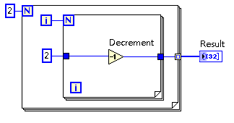
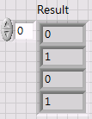
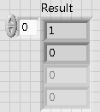
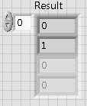
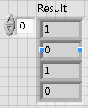
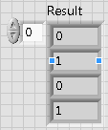
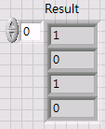
27/40（auto-indexing預設值0）
What value will be displayed in the Result indicator after the VI completes execution?
  B. C. D.
Notes:
A：X
B：
C：
D：X

Slide 12
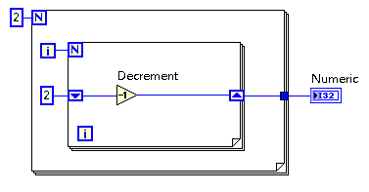
35/40（n=0不執行loop）
What value will be displayed in the Numeric indicator when the VI completes execution?
  0
  1
  2
  4
Notes:
A：
B：
C：
D：

Slide 13
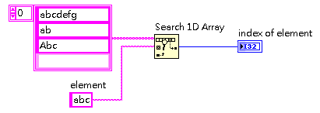
36/40
The Start index (0) input terminal of Search 1D Array is unwired.
What value will be displayed in the index of element indicator after this code completes execution?
  -1
  0
  1
  2
Notes:
A：
B：XXX
C：X
D：X

Slide 14
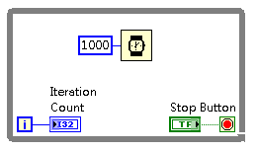
38/40
The Stop Button is pushed when the Iteration Count indicator reads 1, and released exactly 2 seconds later. The Button’s mechanical action is set to Switch Until Released.
What is the highest possible value displayed on the Iteration Count indicator when the VI completes execution?
  1
  2
  3
  infinite
JH
Notes:
A：XXXXX
B：
C：XX
D：

Slide 15
39/40
When attempting to create a new file, a user receives am error 8, “File permission error.”
What could cause this?
  The user does not have permission to write in the specific directory
  The user does not have permission to read the directory listing
  The path is on a remote drive and the network connection failed
  The file is missing
Notes:
A：
B：XXX
C：
D：

Slide 16
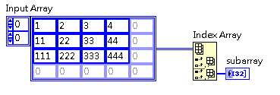




40/40
The row and column terminals are not wired on the Index Array function.
What value will be displayed in the subarray indicator when VI completes execution?
Notes:
A：XXXXXX
B：
C：XX
D：

Slide 17
背
Which statement about custom controls and type definitions is true?
  Each instance of a custom control must be a type definition.
  A type definition defines the data type for all instances of the custom control.
  A strict type definition is a template for creating custom controls.
  A custom control is created using the control editor while a type definition is created programmatically.
JH
Notes:
A：
B：
C：XX
D：XXX

Slide 18
背
Which best describes the Key Down? filter event?
It is an indication that:
  an event occurred and LabVIEW has not processed it
  the event has occurred and LabVIEW will always process it
  the event occurred and LabVIEW processed it
  the event did not occur but specified Event timeout did occur
Notes:
A：
B：X
C：XXXXX
D：XX

Slide 19
背
Which design pattern is most appropriate for applications that temporarily generate data faster than they process data?
  Producer/Consumer
  State machine
  SubVI
  Functional Global Variable
JH
Notes:
A：
B：X
C：X
D：

Slide 20
背
What are the three main elements of the Waveform data type?
  dt, X, Y
  t0, X, Y
  t0, dt, Y
  t0, dt, dY
JH
Notes:
A：X
B：
C：
D：XX

Slide 21
背
Which of the following techniques can be used for testing a VI’s response to unexpected data values?
  Using NaN as the value for a string control.
  Using -lnf as the value for a string control.
  Using “NaN” for the value of a DBL numeric control.
  Using -lnf for the value of a I32 numeric control.
Notes:
A：XX
B：X
C：
D：XX

Slide 22
背
Which is not a benefit of using LabVIEW Project Explorer?
With the LabVIEW Project Explorer, you can:
  Easily find and organize files from within the development environment.
  Make copies of VIs and save them on disk.
  Prevent, detect, and resolve incorrect links.
  Preserve links when moving or renaming files.
Notes:
A：XXX
B：
C：XX
D：X

Slide 23
背
Which statement best describes the use of Notify event, such as the Mouse Enter?
  Indication that an event occurred and LabVIEW did not process the event
  Indication that the event occurred and processing is pending
  Indication that the event occurred and LabVIEW processed the event
  Indication that the event occurred and the event will be processed depending one the case
Notes:
A：XX
B：X
C：
D：XXX

Slide 24

背
Of the following techniques, which method is most appropriate for debugging a broken wire?
  Place a probe before and after the broken wire.
  Mouse over the red X and read the tip strip.
  Use the Remove Broken Wires menu.
  Single-step through the VI at the location of the broken wire.
JH
Notes:
A：
B：
C：XXX
D：

Slide 25
背
You enable the Retain Wire Values button on the block diagram toolbar and run a VI.
Which of the following is correct about the use of Retain Wire Values functionality?
  Retain Wire Values improves VI performance by keeping previous values available on the wires for future loop iterations.
  Retain Wire Values allows you to use a probe to see the last value on each wire after a VI has finished executing.
  Retain Wire Values allows you to save values in the wires when the VI finishes execution so that the VI can use them the next time it executes.
  Retain Wire Values allows you to store default values in the wires on the block diagram rather than in your controls and indicators on the front panel.
Notes:
A：X
B：
C：XX
D：XX

Slide 26
背
A VI is required to change a control on its front panel Enabled to Disabled as needed.
What is the most common way to make these changes?
  Property Node
  Invoke Node
  Local variable
  Functional Global Variable
Notes:
A：
B：XXXX
C：X
D：X

Slide 27
背
By default, with automatic error handing enabled, LabVIEW automatically handles any known error that occurs when a VI is running by doing all of the following except
  Suspending execution.
  Displaying the Error List window.
  Highlighting the subVI, node, or function where the error occurred.
  Displaying an error dialog box.
JH
Notes:
A：X
B：
C：
D：XX

Slide 28
背
Which of the following groups contains items that are all controls?
  Rocker, Horizontal Fill Side, Cluster Constant
  Text Box, Build Array, Table
  Knob, Waveform Graph, OK Button
  Dial, Tab Control, Property Node
Notes:
A：X
B：X
C：
D：XX

Slide 29
背
Which is not a benefit of using SubVIs?
  SubVIs help keep the block diagram less cluttered.
  SubVIs simplify debugging.
  SubVIs allow more rapid creation of repeated code.
  SubVIs eliminate race conditions.
Notes:
A：X
B：X
C：X
D：

Slide 30
背
Which of the following is an essential manual step to create a SubVI from a section of Code?
  Select the section of block diagram you want to convert to a SubVI
  Setting Required, Recommended, and Optional input and output terminals.
  Configure the Connector Pane to have enough terminals for all inputs and outputs.
  Build the Connector Pane by assigning terminals to the needed indicators and controls.
JH
Notes:
A：
B：
C：X
D：X

Slide 31
背
Which of the following statements most correctly defines a LabVIEW Functional Global Variable?
  A function in LabVIEW that looks like a variable and is not re-entrant.
  A SubVI with a local variable that functions like a global variable.
  A SubVI that has a uninitialized shift register, and holds global data.
  A SubVI that has an initialized shift register, and holds global data.
JH
Notes:
A：
B：
C：
D：XXXX

Slide 32
背
Which of the following is a property or method of the VI class?
  Label.Text
  Key Focus
  Default Values:Reinitialize All To Default
  Terminal.Bounds:Area Width
JH
Notes:
A：XXX
B：
C：
D：XX

Slide 33
背
Which structure is most appropriate for code that reads and evaluates continuous measurements and then stops and outputs a signal when the measured values reach a threshold?
  Case structure
  For Loop
  While Loop
  Sequence structure
JH
Notes:
A：
B：X
C：
D：

Slide 34
？
Which of the following statements about probing wire values for debugging is false?
  Retain Wire Values allows you to see the last value on the wire after execution.
  Setting probes on a wire allows you to see values on the wire after execution.
  Retain Wire Values allows you to see all the values from each loop iteration after execution.
  Setting probes on a wire allows you to see the last value of an iteration of a loop after execution.
Notes:
A：X
B：
C：
D：X

Slide 35

When writing data to a file using the Write to Binary File function, what data types can you use?
  Any but a cluster
  Any but a string
  Any
  Any but a dynamic data type
PH
Notes:
A：XXX
B：
C：
D：XXXX

Slide 36

What does this function do?
  Removes the queue from memory
  Sorts all queue elements in order
  Removes all elements from the queue and returns them as any array
  Sets all values of the queue to the default value
YH
Notes:
A：X
B：
C：?
D：

Slide 37
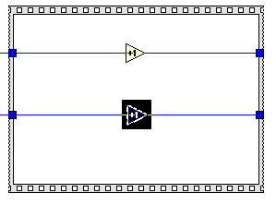
When using single step debugging, the VI execution is paused at the increment node. Which of the following actions is not possible?
  Step Out of the Sequence Structure.
  Step Over the Increment function.
  Finish Frame of the structure.
  Un-pause and continue execution.
JH
Notes:
A：
B：
C：XX
D：

Slide 38
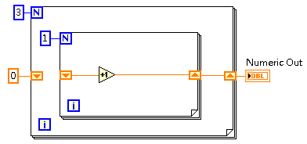
The following VI has run more than once.
What value will be displayed in the Number Out indicator after this VI is executed the next time?
  1
  3
  0
  Indeterminate
Notes:
A：XX
B：XX
C：X
D：

Slide 39

The length and index input terminals on the Delete From Array function are not wired.
What will be the value of the outputs of the Delete From Array function after the VI completes execution?
  array = [1, 2], deleted element = 3
  array = [2, 3], deleted element = 1
  array = [1, 2, 3], deleted element = 0
  The VI is broken because the ‘index’ input to Delete From Array is unwired.
Notes:
A：
B：XXX
C：XX
D：XX

Slide 40
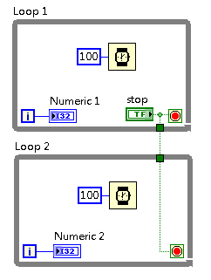
What is the behavior when the code executes?
  Loop 1 and Loop 2 run simultaneously.
  Loop 1 runs after Loop 2 stops.
  Loop 2 runs after Loop 1 stops.
  Loop 1 and Loop 2 are deadlocked.
JH
Notes:
A：XXX
B：
C：
D：XXXX

Slide 41

There is a breakpoint before the Square function as show below.
When LabVIEW pauses execution at execution at that breakpoint, what will happen if you press the (Step Into) button?
  LabVIEW will highlight the Square function but will not execute it.
  LabVIEW will open up the block diagram of the Square function to allow you to single step through the code inside the Square function.
  LabVIEW will execute the Square function and then highlight the next node to be executed as you continue single-stepping through the VI.
  LabVIEW will complete the execution of the VI and return to the calling VI (if one exists).
Notes:
A：X
B：XXXXXXX
C：
D：X

Slide 42

In the process of debugging a VI, You have placed a breakpoint before Square Function.vi as shown below in order to single-step through the code.
When you suspend execution at that breakpoint, what will happen if you press the (Step Over) button?
  LabVIEW will complete the execution of the current VI and return to the calling VI (if one exists).
  LabVIEW will skip the execution of Square Function.vi, in order to Step Over that function and continue single-stepping through the VI.
  LabVIEW will open up the block diagram of the Square Function.vi to allow you to single step through the code inside the function.
  LabVIEW will execute the Square Function.vi and then highlight the next node to be executed as you continue single-stepping through the VI.
JH
Notes:
A：
B：XXX
C：
D：

Slide 43
When using single step debugging with a SubVI which of the following is NOT possible?
  Step Into ( ) while the execution flow is paused on the SubVI icon.
  Step Out ( ) while the execution flow is paused on a node inside the block diagram of the SubVI.
  Finish VI ( ) while the execution flow is paused on the block diagram of the SubVI.
  Finish Block Diagram ( ) while the execution flow is paused on a node inside the SubVI.
Notes:
A：X
B：
C：X
D：XX

Slide 44
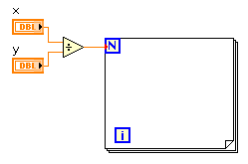
If the value in X is 93 and Y is 10, how many iterations does the loop execute?
  0
  9
  10
  LabVIEW will throw a run time error
YH
Notes:
A：
B：
C：
D：XXX

Slide 45
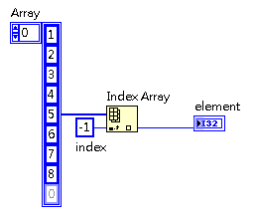
What value will be displayed in the element indicator after the VI completes execution?
  0
  1
  8
  NaN
YH
Notes:
A：
B：XX
C：
D：XXXXXX

Slide 46

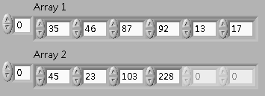




What will the Result indicator look like after the VI completes execution?
YH
Notes:
A：
B：XXX
C：
D：

Slide 47

What are the data type and value at the output terminal of the Round to Nearest function after the VI completes execution?
  I32 with value -4
  I32 with value 4
  DBL with value -4
  DBL with value 4
YH
Notes:
A：XX
B：
C：
D：

Slide 48
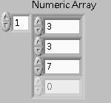
Which of the following statements is TRUE about Numeric Array?
  It is an indicator.
  It contains exactly 4 elements.
  It contains exactly 3 elements.
  It is two-dimensional.
Notes:
A：
B：
C：XX
D：XXX

Slide 49
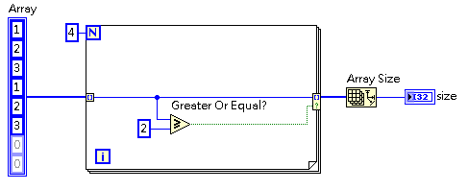
What value will be displayed in the size indicator after the VI completes execution?
  2
  3
  4
  6
Notes:
A：
B：X
C：X
D：XXX

Slide 50
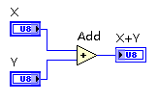
The VI begins execution with the value of X =255 and Y =9.
What will be the value of X+Y after the VI completes execution?
  0
  8
  255
  264
YH
Notes:
A：XX
B：
C：XX
D：

Slide 51
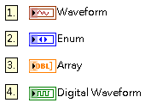
Which of following data types contains a timestamp?
  1 and 2
  1,2 and 4
  1 and 4
  1,2 and 3
JH
Notes:
A：
B：XX
C：
D：XX

Slide 52
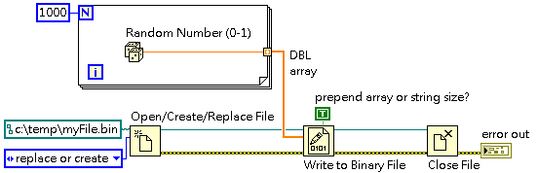
How large is the file produced by this code?
  1000 bytes
  2000 bytes
  4000 bytes
  8000 bytes
JH
Notes:
A：X
B：
C：XXXX
D：

Slide 53
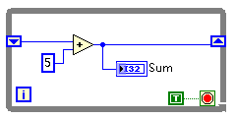
The following SubVI is loaded into memory and then run.
What is the value of Sum when the VI completes execution?
  5
  10
  There is no way to know
  0
Notes:
A：
B：XX
C：X
D：XXX

Slide 54
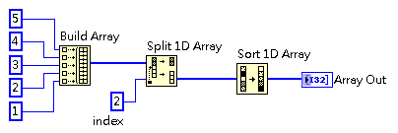




What value will be displayed in the Array Out indicator after the VI completes execution?
YH
Notes:
A：X
B：X
C：
D：X

Slide 55
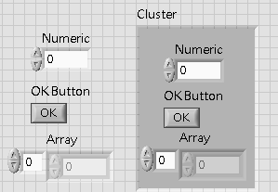
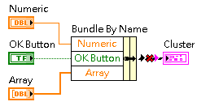
沒有input cluster
Why is there a broken wire?
  The Cluster is nit a Type Definition.
  The input cluster for the Bundle by Name function is not defined
  The Numeric is not the right kind for the cluster
  The controls contain different types if data than the Cluster
JH
Notes:
A：
B：
C：XX
D：XXX

Slide 56
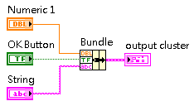
Which of the following statements is FALSE about what actions can be performed with the output cluster of the Bundle function?
  The Cluster To Array function can be used to make an array of the output cluster’s elements.
  The Unbundle By Name function can be used to access the elements by name.
  The Unbundle function can be used to access the elements by data type.
  The Build Cluster Array function can be used to build an array of the output clusters.
Notes:
A：
B：XX
C：X
D：X

Slide 57
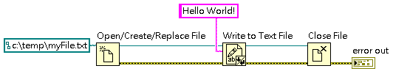
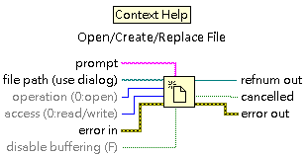
The operation and access input terminals are unwired on the Open/Create/Replace File function.
Which condition would not produce error code 7, “File not found” when the VI execution?
  The file myFile.txt does not exist.
  The location of myFile.txt is incorrect.
  The operation terminal is not set to “create”.
  The access is not set to write.
Notes:
A：XX
B：XX
C：XX
D：

Slide 58
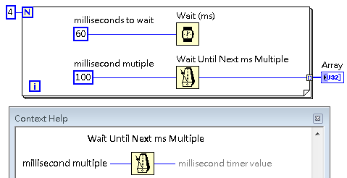
What will be the difference in value between the elements of Array after the VI completes execution?
  A multiple of 40 ms
  A multiple of 100 ms
  A multiple of 160 ms
  Indeterminate
JH
Notes:
A：XXX
B：
C：XXX
D：

Slide 59
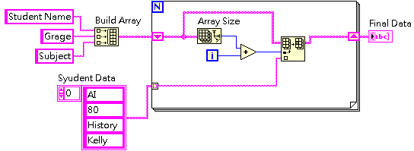
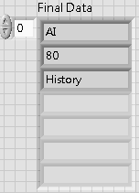
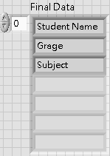
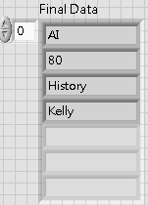
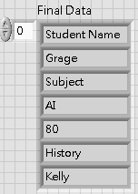
What value will be displayed in the Final Data indicator after the VI completes execution?
  B. C. D.
Notes:
A：XXX
B：
C：XX
D：XXX

Slide 60
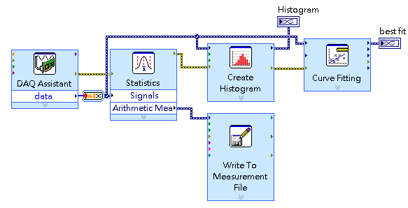
Which Express VI executes last?
  Indeterminate
  Write to Measurement file
  Create Histogram
  Curve Fitting
JH
Notes:
A：
B：X
C：
D：X

Slide 61
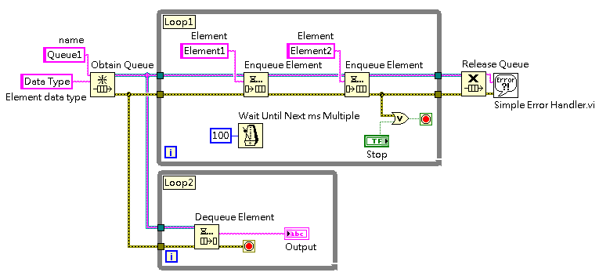
What value will be displayed in the Output indicator when the third iteration (i=2) of Loop 2 completes?
  Queue1
  Element1
  Element2
  Element1Element2
JH
Notes:
A：XXX
B：
C：XX
D：

Slide 62
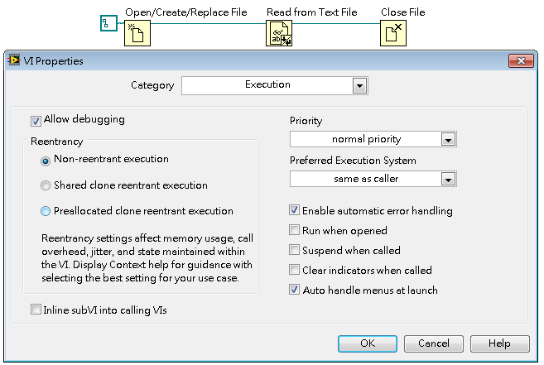
The following VI has Execution properties configured as shown.
What happens when the VI is executed?
  No error is displayed because closing the file reference will clear the error.
  LabVIEW clears the error because automatic error handling is enabled.
  LabVIEW interrupts execution to report the error.
  LabVIEW displays the error only at the end of execution.
JH
Notes:
A：
B：X
C：
D：XX

Slide 63
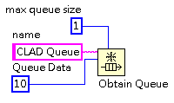
A VI’s queue is configured in the following manner, and the VI uses only Enqueue Element function to put elements in the queue.
Which statement describes the correct behavior when elements are enqueued?
  Up to ten elements maximum will be in the queue
  When full, the queue will not accept more elements until an element is removed
  New elements will continuously overwrite the one element in the queue
  The queue will return ten elements for each dequeue
JH
Notes:
A：
B：
C：XX
D：

Slide 64
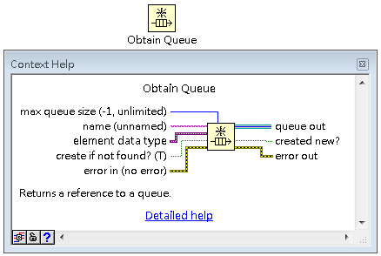
What types of data can be wired to the Obtain Queue function as the element data type?
  Only Cluster, String, Numeric, and Boolean
  Any LabVIEW data type
  Only Clusters and Strings
  Only Variants
JH
Notes:
A：
B：
C：X
D：

Slide 65

Starting with the code below, you need to create a SubVI that will concatenate the two input strings, compare the result to a standard string and output a Boolean result. The standard string will never change.
What must be done to accomplish this goal?
  Convert all the string constants to controls.
  Convert Input String1 and Input String2 to controls.
  Make sure that all the string constants are selected before creating the SubVI.
  Make sure all controls and indicators are selected before creating the SubVI.
JH
Notes:
A：
B：
C：
D：XX

Slide 66
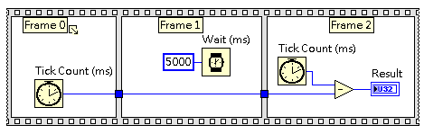
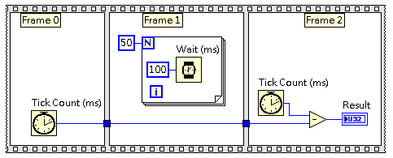
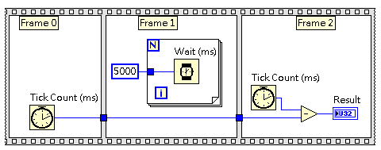


Which code snippet is not functionally equivalent to the sequence structure below?
  C.
  D.
JH
Notes:
A：
B：
C：
D：XXX

Slide 67

Which of the following is true after the VI completes execution?
  data.bin can only be open by a custom made application that reads binary format.
  data.bin will not allow data to be written because of a data type mismatch.
  data.txt and data.bin will write identical files.
  A latch condition will prohibit the two files from writing data at the same time.
Notes:
A：
B：XX
C：XX
D：X

Slide 68

(刪去法)
Why does the VI result in a broken run arrow?
  Because of the coercion dot on the Multiply function.
  Output does not match the dimensions of the output of the Multiply function.
  The Count terminal is unwired.
  A scalar cannot be multiplied with an array.
PH
Notes:
A：
B：XX
C：
D：X

Slide 69




The Trigger control is configured with a latching mechanical action. The VI required to display a Count value that tracks the number of Value Change events that occur for the Trigger.
Which of the code snippets meets that requirement when the VI is run?
  C.
  D.
JH
Notes:
A：
B：XXXX
C：
D：X

Slide 70





Which code snippet results in this front panel?
  C.
  D.
JH
Notes:
A：
B：
C：
D：XX

Slide 71



The Case structure in this VI has three cases, show below.
What value will be displayed in the iteration indicator after this VI completes execution?
  2
  3
  1
  0
JH
Notes:
A：XXX
B：XX
C：
D：

Slide 72




What value will be displayed in the Out indicator when this VI completes execution?
  Case0
  Case1
  Case2
  Case3
JH
Notes:
A：
B：
C：X
D：

Slide 73


The output tunnel on the error wire passing through this Case Structure causes a broken arrow.
Which of the shortcut menu items would preserve error data in all cases?
  Use Default If Unwired.
  Linked Input Tunnel >> Create & Wire Unwired Cases.
  Cluster, Class, & Variant Palette >> Build Cluster Array
  Create >> Indicator
Notes:
A：XXXX
B：
C：X
D：XX

Slide 74

The following VI is broken because of the unwired output tunnel on the case structure.
When the user right-click the output tunnel, why is the Linked Input Tunnel menu item not enabled?
  Use Default if Unwired does the same thing as Linked Input Tunnel in this situation
  Use Default if Unwired is only available for tunnels on For Loops
  Linked Input Tunnel requires at least one input tunnel
  Linked Input Tunnel is only enabled on input tunnels
JH
Notes:
A：X
B：
C：
D：XX

Slide 75

What is the best practice to prevent the coercion dots on a VI like this one?
  Create the Case Selector with a data type matching the Enum data type.
  Create the Selector Terminal with a data type of numeric.
  Create the Enum as a Type Definition and only use the Type Def on the diagram.
  Create the While Loop terminals with indexing enabled.
Notes:
A：XX
B：X
C：
D：X

Slide 76

What happens when the user clicks the window panel close button while the VI executes?
  The VI stops running and the VI window closes
  The VI stops running, but the VI window remains open
  The VI continues running
  The VI stops running and LabVIEW exits
JH
Notes:
A：X
B：XXX
C：
D：

Slide 77



Which of the following VIs will generate a human-readable text file?
  1
  2
  3
  1 and 3
JH
Notes:
A：
B：XXX
C：
D：X

Slide 78

The Filter section Enum is set to “Bessel”.
What value will be displayed in Numeric when the VI completes execution?
  0
  22
  Indeterminate. Must see the code in other cases to determine the value.
  The VI does not stop execution and run indefinitely.
JH
Notes:
A：
B：XX
C：X
D：

Slide 79




You VI must take an error cluster as an input. If the error cluster contains an error, return that error, but if there is no error, set error code 7 (file not found).
Which VI does not meet these requirements?
PH.JH
Notes:
A：X
B：XXX
C：
D：

Slide 80




A VI takes an input error cluster. If the cluster contains an error with code = 1 or code 2, the VI should clear the error.
Which diagram best implements this functionality?
  C.
  D.
JH
Notes:
A：
B：
C：XX
D：

Slide 81

Which of the following scenarios would cause this VI to be broken?
  String has a default value other than “test1” or test2”.
  A string data type cannot be wired to a case selector.
  The selector tunnel is not wired within the case structure.
  The case structure does not have a Default case.
JH
Notes:
A：X
B：
C：
D：

Slide 82





What value will be displayed in the concatenated string indicator after the VI completes execution?
YH
Notes:
A：
B：X
C：
D：

Slide 83
?
Which data synchronization mechanism ensures that no data is lost when an application temporarily produces data faster
  Notifier
  Queue
  Functional Global Variable
  Local Variable
Notes:
A：
B：
C：X
D：

Slide 84
關於序列本端端點 (Sequence local terminal) 的敘述，下列何項正確？
(請選出所有適用的敘述)
  序列本端端點可從任一框架，將資料傳送至任何子序列框架
  當資料離開框架，序列本端端點隨即出現向外箭頭
  序列本端端點可從任一框架，將資料傳送至任何先前的框架
  將 Stacked Sequence Structure 置入程式圖之後，隨即自動建立序列本端端點
Notes:
A：
B：
C：
D：

Slide 85
在單一迴圈中，若有1組「Wait Until Next ms Multiple」函式具備常數100，且其所連接的程式碼區段需 37 ms 完成第四次循環，則需等待多久時間才會開始下次循環？
  14 ms
  63 ms
  100 ms
  437 ms
Notes:
A：
B：
C：X
D：

